Slide 1
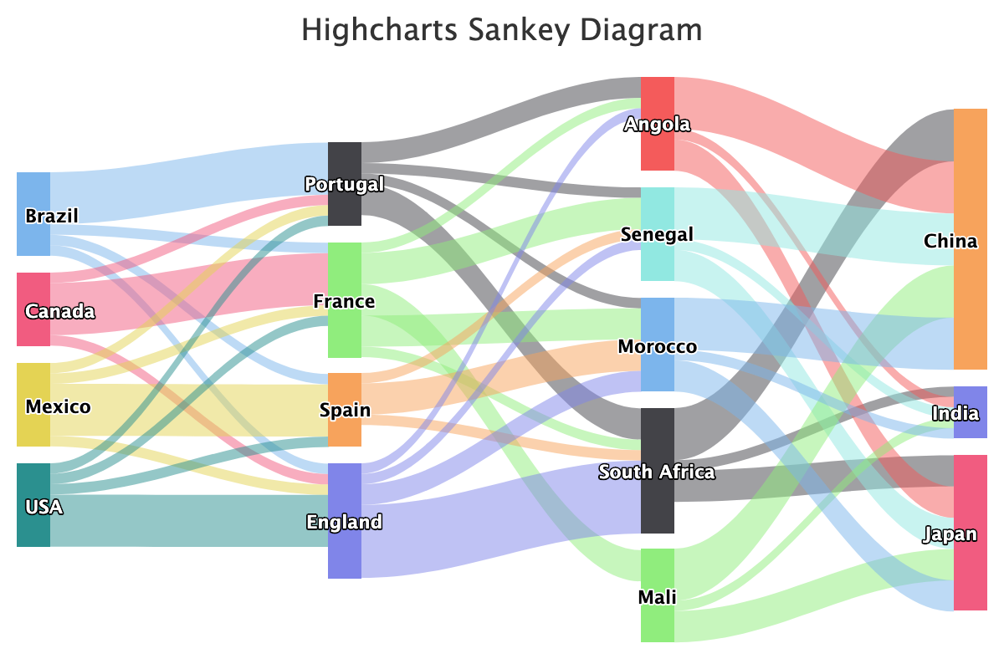
Sankey diagram example

Slide 2
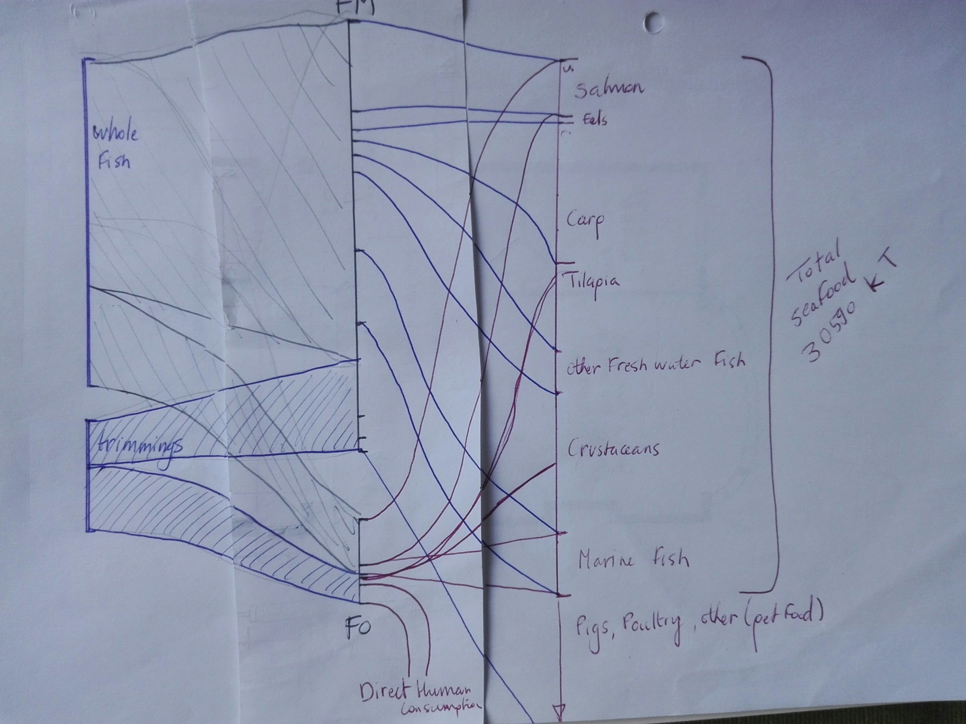
Business-as-usual resource flow
Producing
30 million tonnes of seafood
pork, poultry, pet food
FO for direct human consumption / supplements

Slide 3
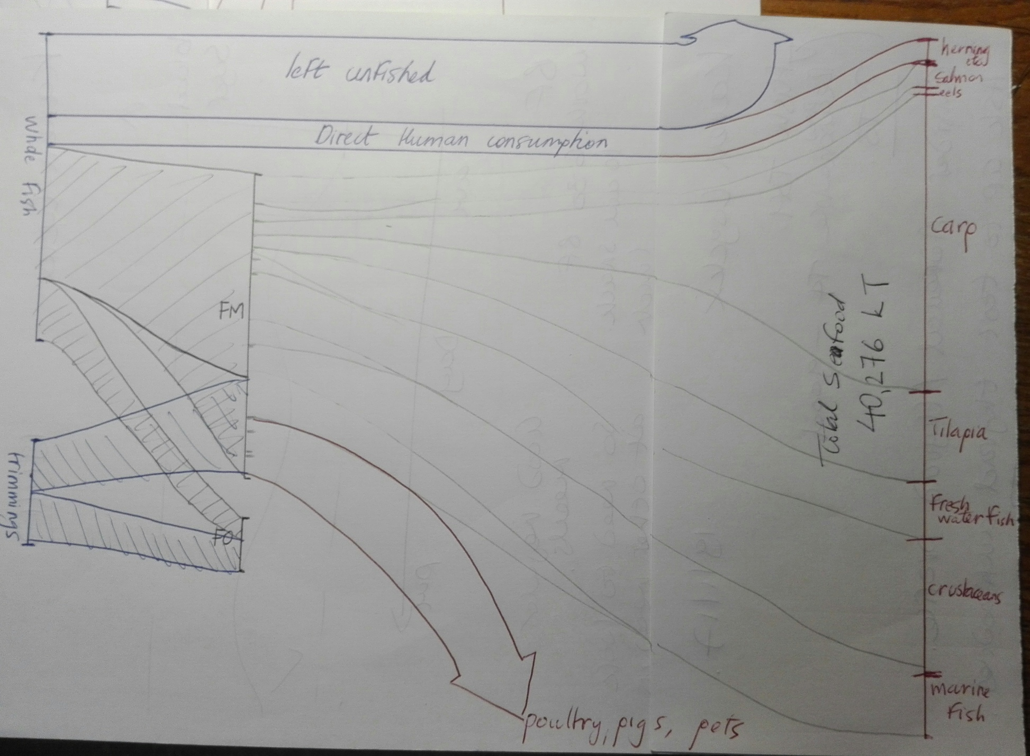
Conceptual reallocation of fish resources currently reduced to FMFO:
4.7 million tonnes of fish left unfished (~ quarter out of 18 million currently reduced to FMFO)
1.5 million tonnes of fish currently reduced to FMFO now instead goes to direct human consumption
Total seafood production: 40 million tonnes (fed aquaculture + the newly freed up forage fish for DHC)
Salmon production: 40% of BAU
Carp production: 225% of BAU
Pork production: 20% of BAU (as per Eat Lancet)
All other farmed seafood, poultry, FO supplements etc remain constant

